Slide 1
Sensor Node Lifetime Analysis: Models and Tools( MATSNL)
The concepts for MATSNL are explained in detail in: Node Lifetime Analysis: Models and Tools , D. Jung, T. Teixeira and A. Savvides , in ACM Transactions on Sensor Networks Volume 5, Feb, 2009
ENALAB
Yale University

Slide 2
Energy Constraint in Wireless Sensor Network
How does a limited energy resource (battery) impact on the design and operation of sensor node (Mote) ?
  Choice of Mote type : (Low-end) ---------------→ (High-end)
  Telos → MICA2 → iMote2 → Stargate
  Sensing Mechanism: Event driven vs. Schedule driven
  Communication Protocol: Synchronous (Scheduled radio wakeup) vs. Asynchronous ( Random radio wakeup or Wake-up radios)
Power measurement and energy breakdown in sensor node is the first step to the cope with the energy constraint
  By components
    Microcontroller, Radio, LED, External Memory , Sensor (board) etc.
  By node operation
    Node Sleep, data collecting (sampling), data processing, data storing, data forwarding etc.
Node Lifetime Analysis and prediction must be evaluated before deployment
  Node lifetime is a function of operation time and node power consumption
    Total Energy Consumption of a Mote =
    ∑ _{components} Power consumption @component x Operation Time @component
  Node lifetime is coupled with sensing/ processing performance
    Trade-off between node lifetime and event detection probability

Slide 3
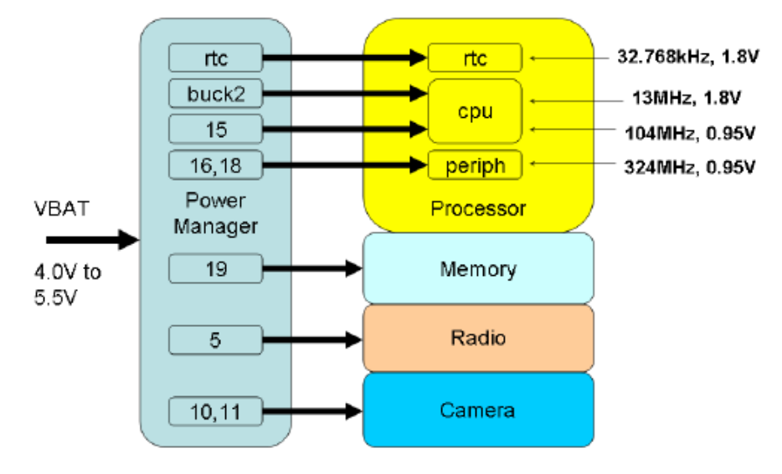
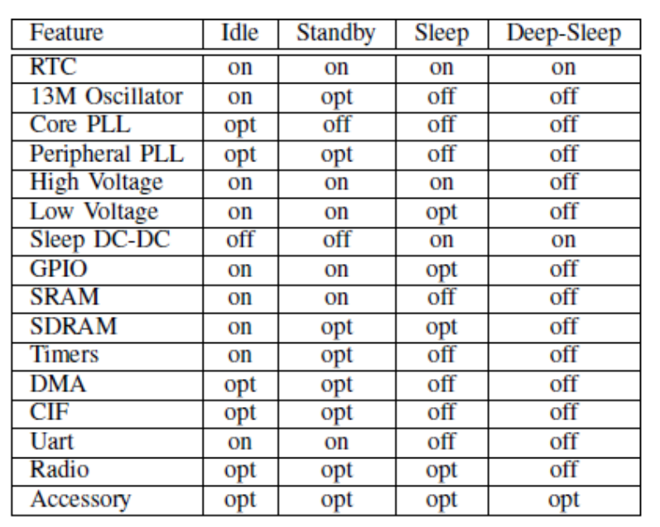
Sensor Node Power Measurements (iMote2)
An Enalab Camera attached to an iMote2 [1]
  The frequency and voltage of the processor is dynamically adjustable for performance and efficiency.
  The processor and power manager coordinate to provide five major power modes: normal, idle, standby, sleep and deep-sleep
  The power manager provides nearly 20 configurable power domains that can enter into power-saving modes when not needed by the processor or peripherals.
  The radio supports an active and a standby mode
Power domains supplied by the power manager to the processor and peripherals.
CONFIGURATION OF THE IMOTE2 FOR POWER MODES IN SOS

Slide 4
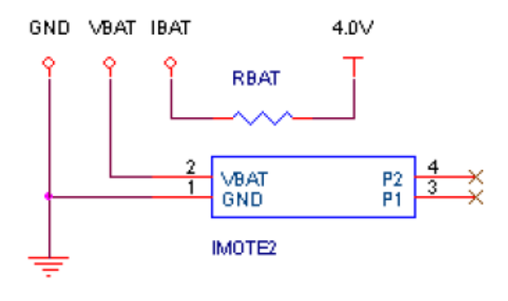
Sensor Node Power Measurements (iMote2)
Power consumption measurement
  The power was computed from the measured values of current and voltage provided to the iMote2 through the battery pads on the board.
  A regulated 4.0V power source was used to supply the voltage for the iMote2.
Circuit used to measure the power consumption of the iMote2 for different power modes and peripherals
The contribution to the power consumption of the iMote2 from the only the Radio or the Camera is estimated using the measured power consumption of the iMote2 with the peripherals.
The estimate of the power consumed by the peripheral in active mode was derived by subtracting the measured power consumption with the peripheral disabled from the power consumption of the peripheral enabled, with the iMote2 in the Normal power mode and the frequency at 104Mhz

Slide 5
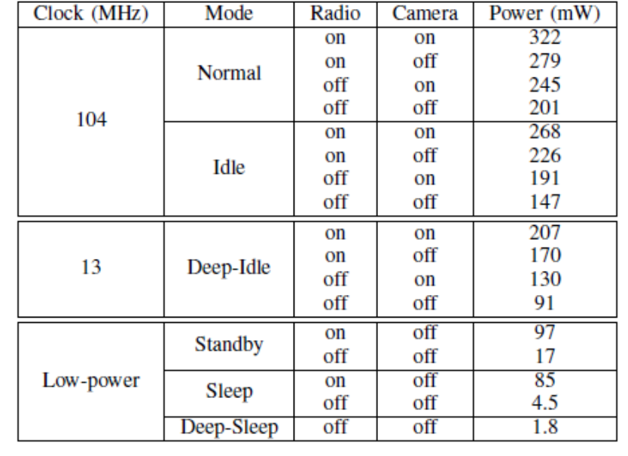
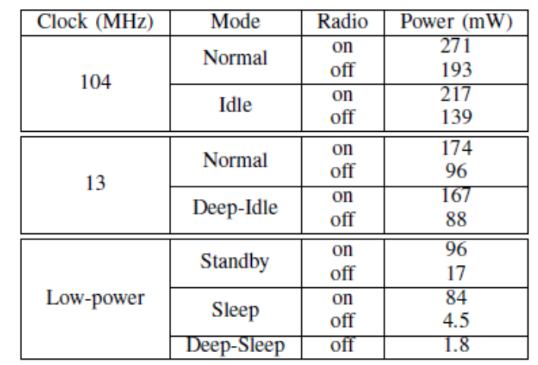
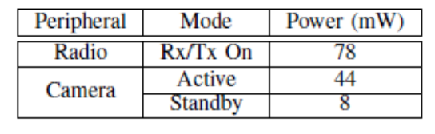
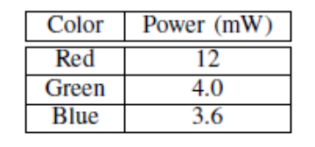
Sensor Node Power Measurements (iMote2)
POWER CONSUMPTION OF THE IMOTE2 AND SOS
POWER CONSUMPTION OF THE IMOTE2 AND THE ENALAB CAMERA
ESTIMATED POWER CONSUMPTION OF THE RADIO AND THE CAMERA.
ESTIMATED POWER CONSUMPTION FOR EACH LED.

Slide 6
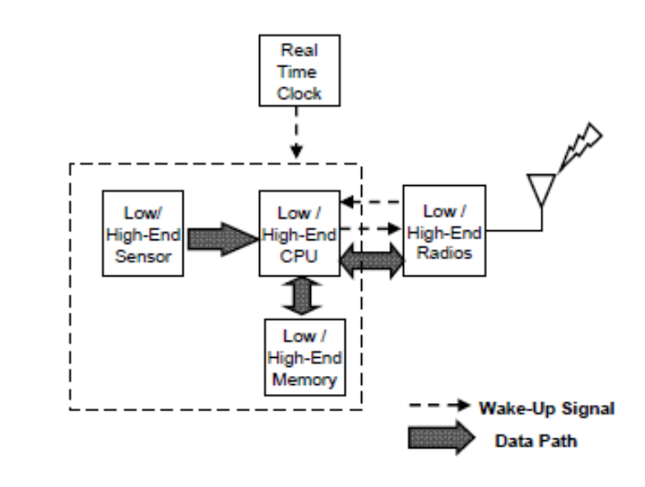
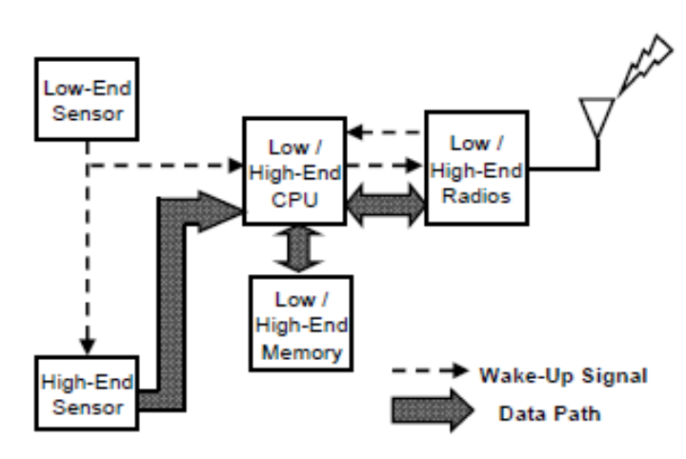
Node Lifetime Analysis and Model
Single Component Platform [2][3]
Sensing Model : Trigger vs. Schedule Driven Operation
Trigger-Driven Strategy
Schedule-Driven Strategy
Intelligent Sensor
Simple Sensor
Processor
Processor
Polling
Interrupt
Event Monitoring
Duty Cycle

Slide 7
Mathematical Model
Semi-Markov Chain provide elegant tool for capturing a random nature of energy consumption pattern by considering “Time” and “Power” simultaneously
  In Semi-Markov process, next state depends on the present state and the length of time the process has spent in this state
The Model simplifies complex behavior of node operation by the following assumptions
  The first-order statistical characteristic (mean value) of all random quantities (events, processing time, etc) is known by observation and experiment.
  The sojourn time at processing and communication stage is small compared to inter-arrival time of events.
  Event arrivals follow a Poisson distribution.
  Processing and radio-transmission times are independent and identically distributed (i.i.d.) with arbitrary distribution.
  When an event is detected, the node processes it and sends the information to a base station (or another node) with probability .
  During the processing period, the CPU visits a limited number of low-power states (e.g. idle state
  During the communication period, the radio visits a limited number of listen
  (idle) states.
  Power consumption is constant during each operation and a fixed amount of energy is required to turn on or off the CPU or radio

Slide 8
Power State Description
Preprocessor (On), Sensor (Off / On), CPU (Off /On /Idle), Radios (Off / Tx / Rx)
CPU On=Busy or Normal / Radio Rx= Listen or Idle
Off = The lowest power mode at each component
C_{P}=CPU Wakeup Energy Cost, C_{R}=Radio Wakeup Energy Cost
Mode | Trigger-Driven Node |  |  | Schedule-Driven Node
 | Preprocessor | CPU | Radio | Sensor | CPU | Radio
S₀ | - | - | - | Off | Off | Off
S₁ | On | Off | Off | - | - | -
S₂ | On | On | Off | On | On | Off
S₃ | On | On | Tx | On | On | Tx
S₄ | On | Idle | Off | On | Idle | Off
S₅ | On | On | Rx | On | On | Rx

Slide 9
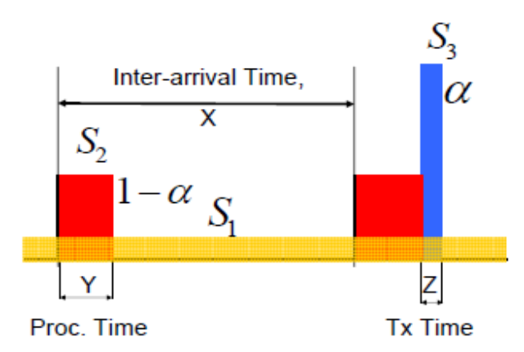
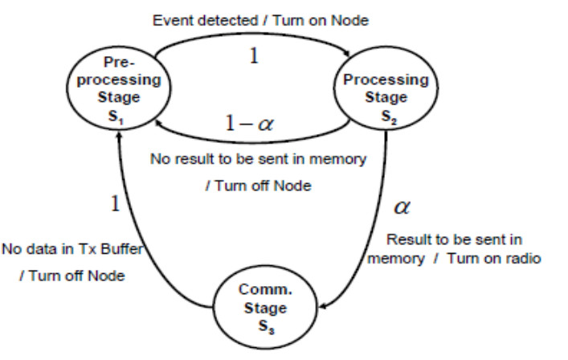
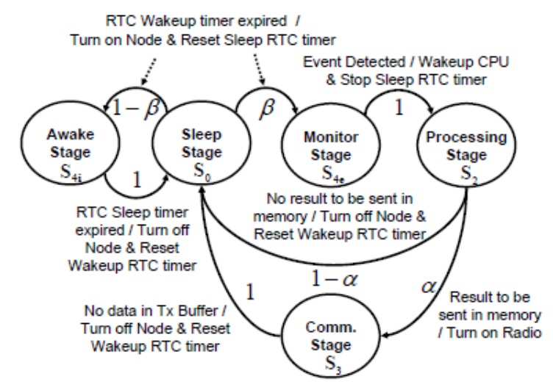
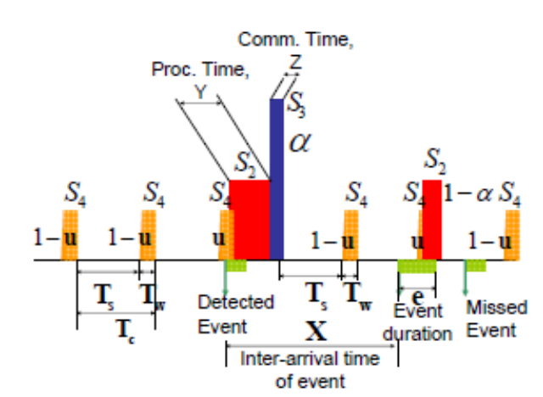
Semi-Markov Model Description
Trigger-Driven Model
Schedule-Driven Model
Power profile of trigger-driven node model
Semi-Markov chain of trigger-driven node model.
Schedule-driven node power profile
Power state transitions for the schedule-driven model

Slide 10
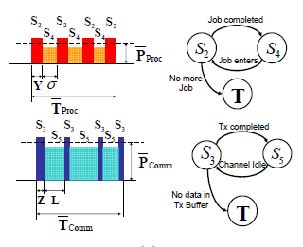
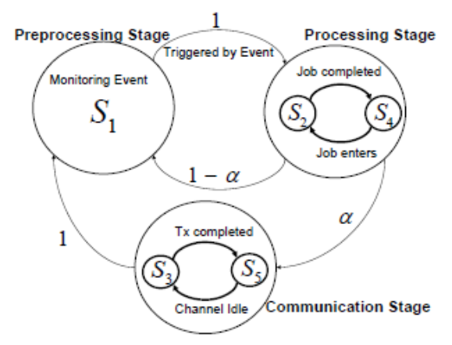
Semi-Markov Model Description
Detailed Model for Processing and Communication Stage
  CPU (radio) iterates idle (listening) state and busy (tx) state
  It can be incorporated as embedded chains in communication and processing stage of semi-markov chain.
Power profile of complete trigger-driven node model
Semi-Markov chain of complete trigger-driven node model

Slide 11
Semi-Markov Model Description
Model Parameters
Symbol | Description | Symbol | Description
α | Probability of sending sensing information | λ | Event Arrival rate, 1/sec
Y | the average processing time per packet | Z | the average transmission time per packet
σ | the average duration of the idle states of the CPU | C_{P} | CPU Wake up energy cost
L | the average channel-listening ( or wait) time of the radio | C_{R} | Radio Wake up energy cost
N_{σ} | the average number of idle states in processing stage, | N_{L} | the average number of listening (or wait) states in communication stage
β | probability of an event being detected during awake period | T_{e} | Event Duration
T_{w} | Wakeup period schedule-driven node | T_{s} | Sleep period schedule-driven node
u | Event detection probability | E_{Total} | Battery Energy, mJ

Slide 12


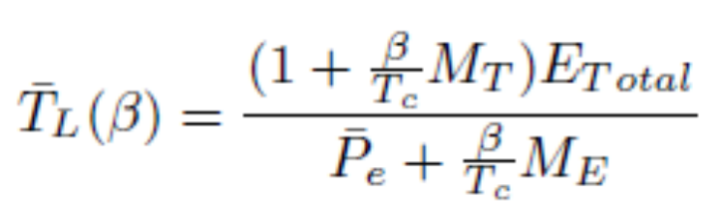
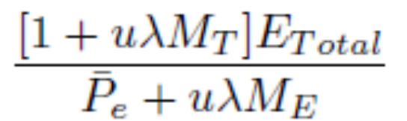
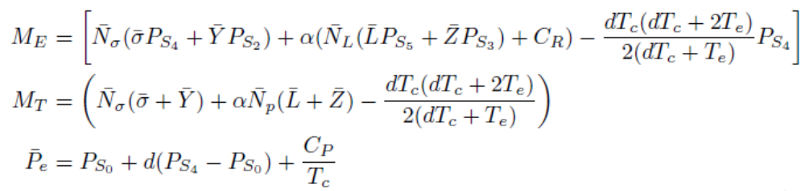
Semi-Markov Model Description
Trigger-Driven Node lifetime Model
Schedule-Driven Node lifetime Model
≈

Slide 13
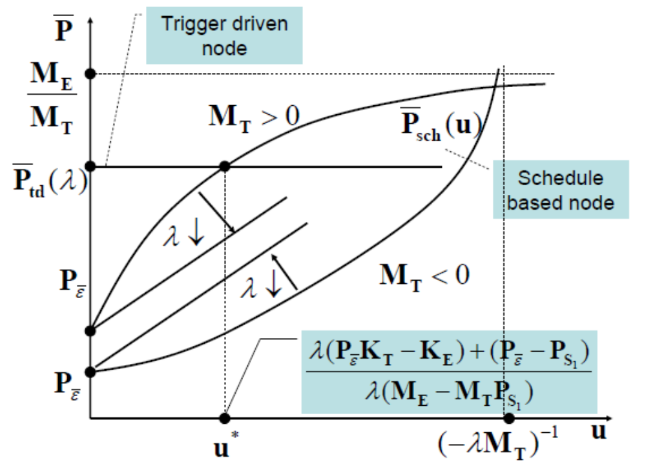

TRIGGER-DRIVEN AND SCHEDULE-DRIVEN COMPARISON
The trigger-driven case,
  Since the sensor and preprocessor are always on, event detection probability is one, but with additional power cost for the preprocessor.
The schedule-driven scheme
  Wakeup time directly affects trade-off between the event detection probability and average power consumption of a node

Slide 14
Node Lifetime Analysis and Model
Heterogeneous Component Platform [4]
Reconfigurable platforms - high & low-end components in one platform
  A large dynamic range of energy and performance trade-off
  Using the most efficient component subset for each task
Its energy efficiency modeling has not been studied well
  Energy efficiency gain given a hardware set?
  Parameters of affecting energy efficiency?
  Optimal operation points given workload?
Sensor
CPU
Radio
Camera
Motion
Sensor
PXA271
TI MSP
802.15.4
CC2420
802.11
5006XS
Inter – Component Communication Link
Notes:
I organize this presentation as following. In the main section, I will give motivation, problem statement and proposed solution.
In this section, I will talk about a big main idea, but not detailed results. It will take around 30-40 min.
Upon committee’s request, I can go over some results in the supplementary section. If you find to need more explanation on the results, you can ask me to explain it, or you can read all details in my prospectus.

Slide 15
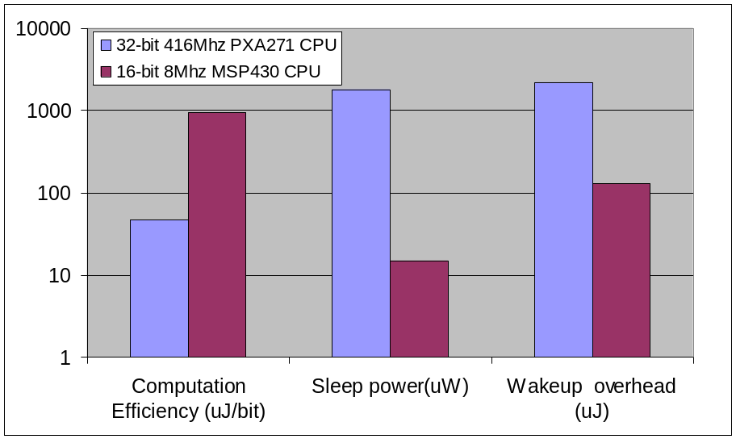
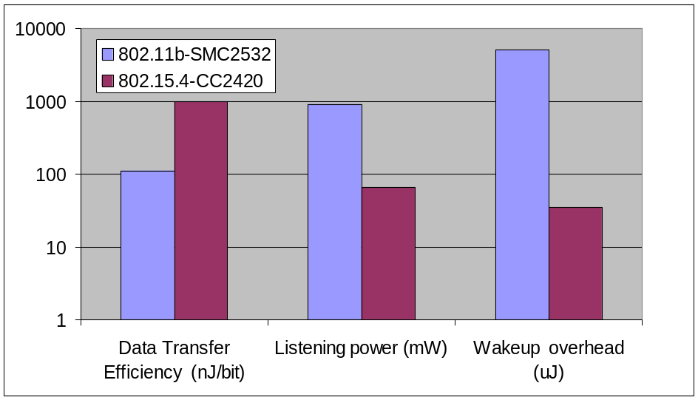
An Energy Efficiency Evaluation for Sensor Nodes with Multiple Processors, Radios and Sensors
A close examination of the power consumption profiles of the components of such nodes suggest that nodes can significantly improve their energy efficiency by utilizing pairs of complementary low-end (low-power), high-end (power-efficient) processors and radios.
Computation cost of 32 bit-FFT and energy efficiency comparison of CPUs
Data transfer cost of and energy efficiency comparison in Radios
Notes:
I organize this presentation as following. In the main section, I will give motivation, problem statement and proposed solution.
In this section, I will talk about a big main idea, but not detailed results. It will take around 30-40 min.
Upon committee’s request, I can go over some results in the supplementary section. If you find to need more explanation on the results, you can ask me to explain it, or you can read all details in my prospectus.

Slide 16
Reconfigurable sensor platforms
Dual-Platform with Serial Interface
  Straight-forward SERIAL design between high-end and low-end platform
  Limited binding among system components
  Lowest interconnect protocol overhead -> Lowest latency
  Limited Bandwidth (< 3.4 Mbps at I²C in High Speed mode)
Control
Control
Flash
Flash
SDRAM
SDRAM
Low-End Radio
(802.15.4)
Low-End CPU
(TI MSP)
MIF
High-End CPU
(PXA271)
MIF
High-End Radio
(802.11)
RIF
RIF
IO
CIF
CIF
IO
RIF
RIF
Voltage Regulator
MUX
Low-End Sensor
(Motion Sensor)
High-End Sensor
(Camera)
Real Time Clock
Notes:
So, our goal is to design energy efficient sensor network to achieve lifetime goal and system objective. For this goal, we take following 3 main approaches. First, bottom up approach. Recently, many literatures study the theoretical analysis on lifetime of wireless sensor network. But, the literatures often oversimplifies or overlooks the node architectural impact on node/ network lifetime. So the analysis is often based on incomplete or wrong assumptions. In our study, we first model the node level lifetimes based on node architecture, and extend our model to network lifetime. Second, cross-layer approach. For maximum network lifetime, we need to optimize all layers considering all interactions. We propose the unified energy management layer. It coexists with existing layers. Third, system design flow. We propose three steps of design flow. It will help designer to explore vast design space. It has three main steps, numerical analysis, model based optimization, and simulation. Details will be follwoed later.

Slide 17
Reconfigurable sensor platforms
Reconfigurable Platform with reconfigurable interconnect
  Maximum Reconfigurability, Complexity, and Power
  Smallest latency and highest throughput.
  Maximum range of power mode -> Fine-grained power control
Voltage Regulator
Low-End Sensor
(Motion Sensor)
High-End Sensor
(Camera)
Real Time Clock
Reconfigurable Interconnect
Inter Component
Router
IO
IO
Component Power control
Shared RAM
and Arbiter
RIF-1
MIF
IO
IO
MIF
RIF-2
Flash
Flash
SDRAM
SDRAM
Low-End Radio
(802.15.4)
RIF-1
Low-End CPU
(TI MSP)
MIF
High-End CPU
(PXA271)
MIF
High-End Radio
(802.11)
RIF-2
IO
IO
Notes:
So, our goal is to design energy efficient sensor network to achieve lifetime goal and system objective. For this goal, we take following 3 main approaches. First, bottom up approach. Recently, many literatures study the theoretical analysis on lifetime of wireless sensor network. But, the literatures often oversimplifies or overlooks the node architectural impact on node/ network lifetime. So the analysis is often based on incomplete or wrong assumptions. In our study, we first model the node level lifetimes based on node architecture, and extend our model to network lifetime. Second, cross-layer approach. For maximum network lifetime, we need to optimize all layers considering all interactions. We propose the unified energy management layer. It coexists with existing layers. Third, system design flow. We propose three steps of design flow. It will help designer to explore vast design space. It has three main steps, numerical analysis, model based optimization, and simulation. Details will be follwoed later.

Slide 18




Model Sensor Operation as a Semi-Markov Decision Chain
Trigger-Driven Energy Management Model
  Power mode, time variable, and transition cost of current state are determined previous decision action A, e.g {l,h}={Low-end CPU, High-end radio }
  Embedded chain in processing stage and communication stage characterizes workload profile in each stage.
Pre-
processing
Stage
S₀
Processing
Stage
S₁
Comm.
Stage
S₂
L | H | O
Using Low-End | Using High-End | Off
Notes:
Let’s remember that components has complimentary properties. Then how to exploits it? For optimizing platform to highly dynamic environments and application range, we can put two complementary parts of hardware, low ends and high ends in one platform. There are two types. One is with static interconnect . The other one is dynamic interconnect . The dual architecture with static interconnect simply use bus to combine high ends and low ends platforms. So it has limited data flow path. Meanwhile in dynamic interconnect, data flow goes from any part to any part. The interconnect act like a small routing chip. But the interconnect chip requires lots of complexity and more power compared to static interconnect.

Slide 19
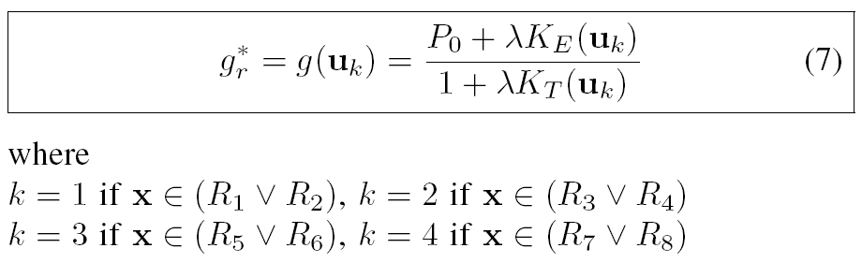
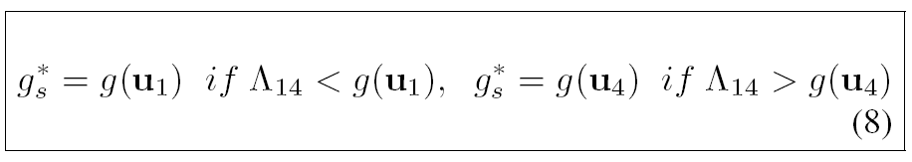
An Energy Efficiency Evaluation for Sensor Nodes with Multiple Processors, Radios and Sensors
Closed form Energy Efficiency Formula
  Solving Bellman equation derived from semi Markov decision process
Decision vectors of CPU and radios
Function of Uk
(Arrival rate, Proc.time in low-end CPU, Proc.time in high end CPU,
Comm.time in low-end Radios, Comm.time in high end Radios,
Notes:
Based on previous node architecture, we derived optimal average power consumptions. I don’t want to go through all details, but want to point out the basic idea behind it. You can find detailed derivation in inform COM paper submitted this year
In order to quantify metric of energy efficiency, we formulate semi markov decision problem. In this formulation, a node takes action called Uk. It ‘s an action of pair choosing low or high end CPU and radios. Then we solve bellman equation for minimizing average cost per cycle. Equation 7 is the average optimal cost .Actually, it turns out that our previous solution for average power consumption is the special case of this solution. R1 to R 8 is the decision region in the decision space. Equation 8 is the solution for dual architecture with static inter connect..
This solutions can be explained intuitively by geometric interpretation.

Slide 20
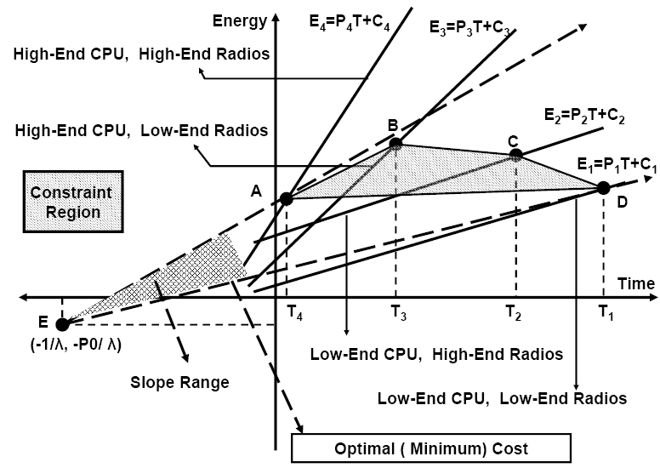
An Energy Efficiency Evaluation for Sensor Nodes with Multiple Processors, Radios and Sensors
Graphical Analysis Example of Energy Efficiency evaluation
  simple low/high-end node and architecture with dynamic interconnect
Notes:
In case of dual architecture with dynamic interconnect, the geometric analysis is formulate in 3-dimensional domain, ( processing time, communication time, and energy). This is illustrative example of 2-D projection of the 3-D geometry in decision space. The 4 straight solid lines stand for energy dissipation rate of different configuration. Let assume preprocessing power and arrival rate are set to point E and time variables for different configurations are set to point A, B, ,C, and D. The area, ABCD forms constraint region. The optimal choice of configuration is determined by the line with smallest slope which is smallest average power cost passing though two regions. In this example, the optimal configuration is using low end CPU and low end radios and the slope range is the maximum gain by the configuration.

Slide 21
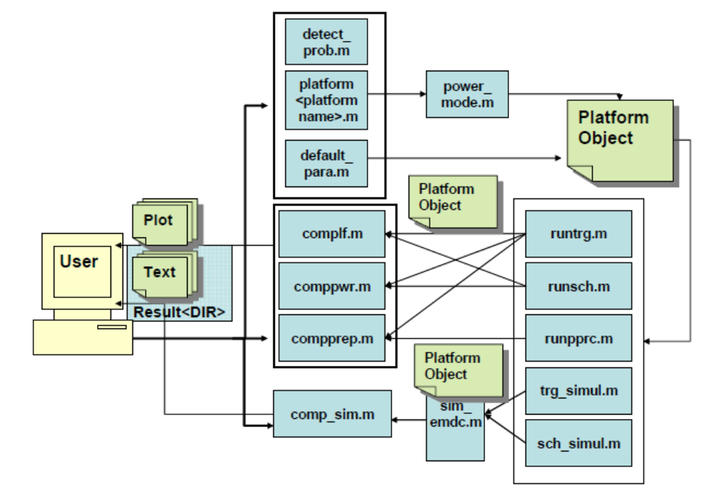
CAPTURING THE MODELS INTO A TOOL – MATSNL [5]
MATLAB™ Wireless Sensor Node Platform Lifetime Prediction & Simulation Package
MATSNL is designed to give the rough power/ lifetime predictions based on node and application specifications while giving useful insight on platform design with side-by-side comparison across various platforms
Using a set of platform and application parameters, the tool predicts node lifetime according to a model and discrete event simulation.
MATSNL user interface

Slide 22
Reference
[1] A. Barton-Sweeney, D. Jung, and A. Savvides. imote2 node and ENALAB camera module power measurements. In ENALAB Technical Report: 090601, Sep 2006.
[2] Model-Based Design Exploration of Wireless Sensor Node Lifetimes, D. Jung, T. Teixeira, A. Barton-Sweeney and A. Savvides, EWSN07, January 2007
[3] Node Lifetime Analysis: Models and Tools , D. Jung, T. Teixeira and A. Savvides , in ACM Transactions on Sensor Networks Volume 5, Feb, 2009
[4] An Energy Efficiency Evaluation for Sensor Nodes with Multiple Processors, Radios and Sensors , D. Jung and A. Savvides , IEEE INFOCOM 2008
[5] MATSNL: MATSNL: A MATLAB Wireless Sensor Node Platform Lifetime Prediction & Simulation Package. (Web: http://enaweb.eng.yale.edu/drupal/MATSNL

